Slide 1
Instructions for creating your own report using this template
Save this PPT file to a new filename
Edit the title slide, and add your own logo, if desired
Log into your dashboard and click the Orchestra Cohort dropdown list to display your own organization’s results along with aggregated results
This template was created with results from the Detroit Symphony Orch.
Replace the charts with DSO data with charts that display your own results
You can download a PNG image file of any chart by clicking the “save as image” button under the chart; or, you can capture the chart using a screen capture
Edit the headlines and bullet points of each slide to reflect the findings of the new chart; if a headline holds true, you needn’t edit it
Need help? Contact Kacie Willis, kacie@wolfbrown.com
Delete this page from the deck

Slide 2
Summary of IDEA Study Results
Detroit Symphony Orchestra

Slide 3
Participating Orchestras

Slide 4
The IDEA study (Phase 1) explores audience attitudes about inclusion, diversity, and equity
Phase 1 Survey (2023) – focused on audience attitudes about inclusion, diversity, and equity
Assess current levels of audience support for DEI work
Identify strategies for creating a more welcoming audience experience
Create measures and baseline metrics for assessing progress on diversity work
Phase 2 Survey (2024) – will focus on the accessibility needs of audiences
Overall, the study aims to support orchestras’ thinking about audiences in connection with their work towards greater inclusion, diversity and equity
Other cohorts of arts groups across the disciplines will deploy the Phase 1 survey in summer and fall 2023

Slide 5
Research Questions, Phase 1
How welcome do audience members feel when they attend an organization’s programs? If they’ve ever felt unwelcome, why?
Do audience members believe that arts organizations, generally, should work towards greater inclusion, diversity, and equity in their management and programming?
To what degree do audience members recognize an organization’s progress towards greater inclusion, diversity, and equity?
Do audience members see themselves as stakeholders in an organization’s work towards greater inclusion, diversity, and equity?
How might audience members become more enfranchised in this work?
How do audience members feel about an organizations’ efforts to diversify artistic offerings?

Slide 6
Survey Methodology
The survey protocol was developed by WolfBrown with input from a range of advisors, tested for face validity in focus groups, and pilot tested
In cooperation with the League of American Orchestras, a cohort of 27 orchestras opted to participate in the Phase 1 study.
Participating orchestras sent emails to recent ticket buyers requesting cooperation with the survey; three strata or samples were surveyed:
Sample 1: Individual ticket buyers to programs intended for culturally diverse audiences (n=2,739)
Sample 2: Individual ticket buyers to classical programs featuring diverse guest artists, conductors, and/or repertoire, on the theory that these programs might attract a somewhat more diverse audience (n=4,870)
Sample 3: A natural mix of subscribers and individual ticket buyers to classical and pops concerts, randomly selected, then purged of Samples 1 and 2 (n=7,168)
A total of 14,843 ticket buyers across the 27 orchestras completed the survey

Slide 7
Dashboard reporting and cohort learning activities
Participating orchestras were able to access results immediately after deployment through the WolfBrown dashboard
All orchestras agreed to transparency, such that everyone can view everyone else’s results, in addition to their own results, as well as aggregate results
This report compares our results with aggregate results
Participating orchestras reflected on the results as a cohort in two webinars on April 26 and May 10, 2023. Recordings of these sessions are available on the cohort webpage.

Slide 8
Basic information about who took the survey

Slide 9
Characteristics of survey respondents
Nearly all respondents had attended one of our programs in the past 12 months
The pool of respondents was split evenly between individual ticket buyers and subscribers (current and former)
Nearly half of all respondents reported making a financial contribution to the orchestra in the past 12 months, over and above the cost of tickets

Slide 10
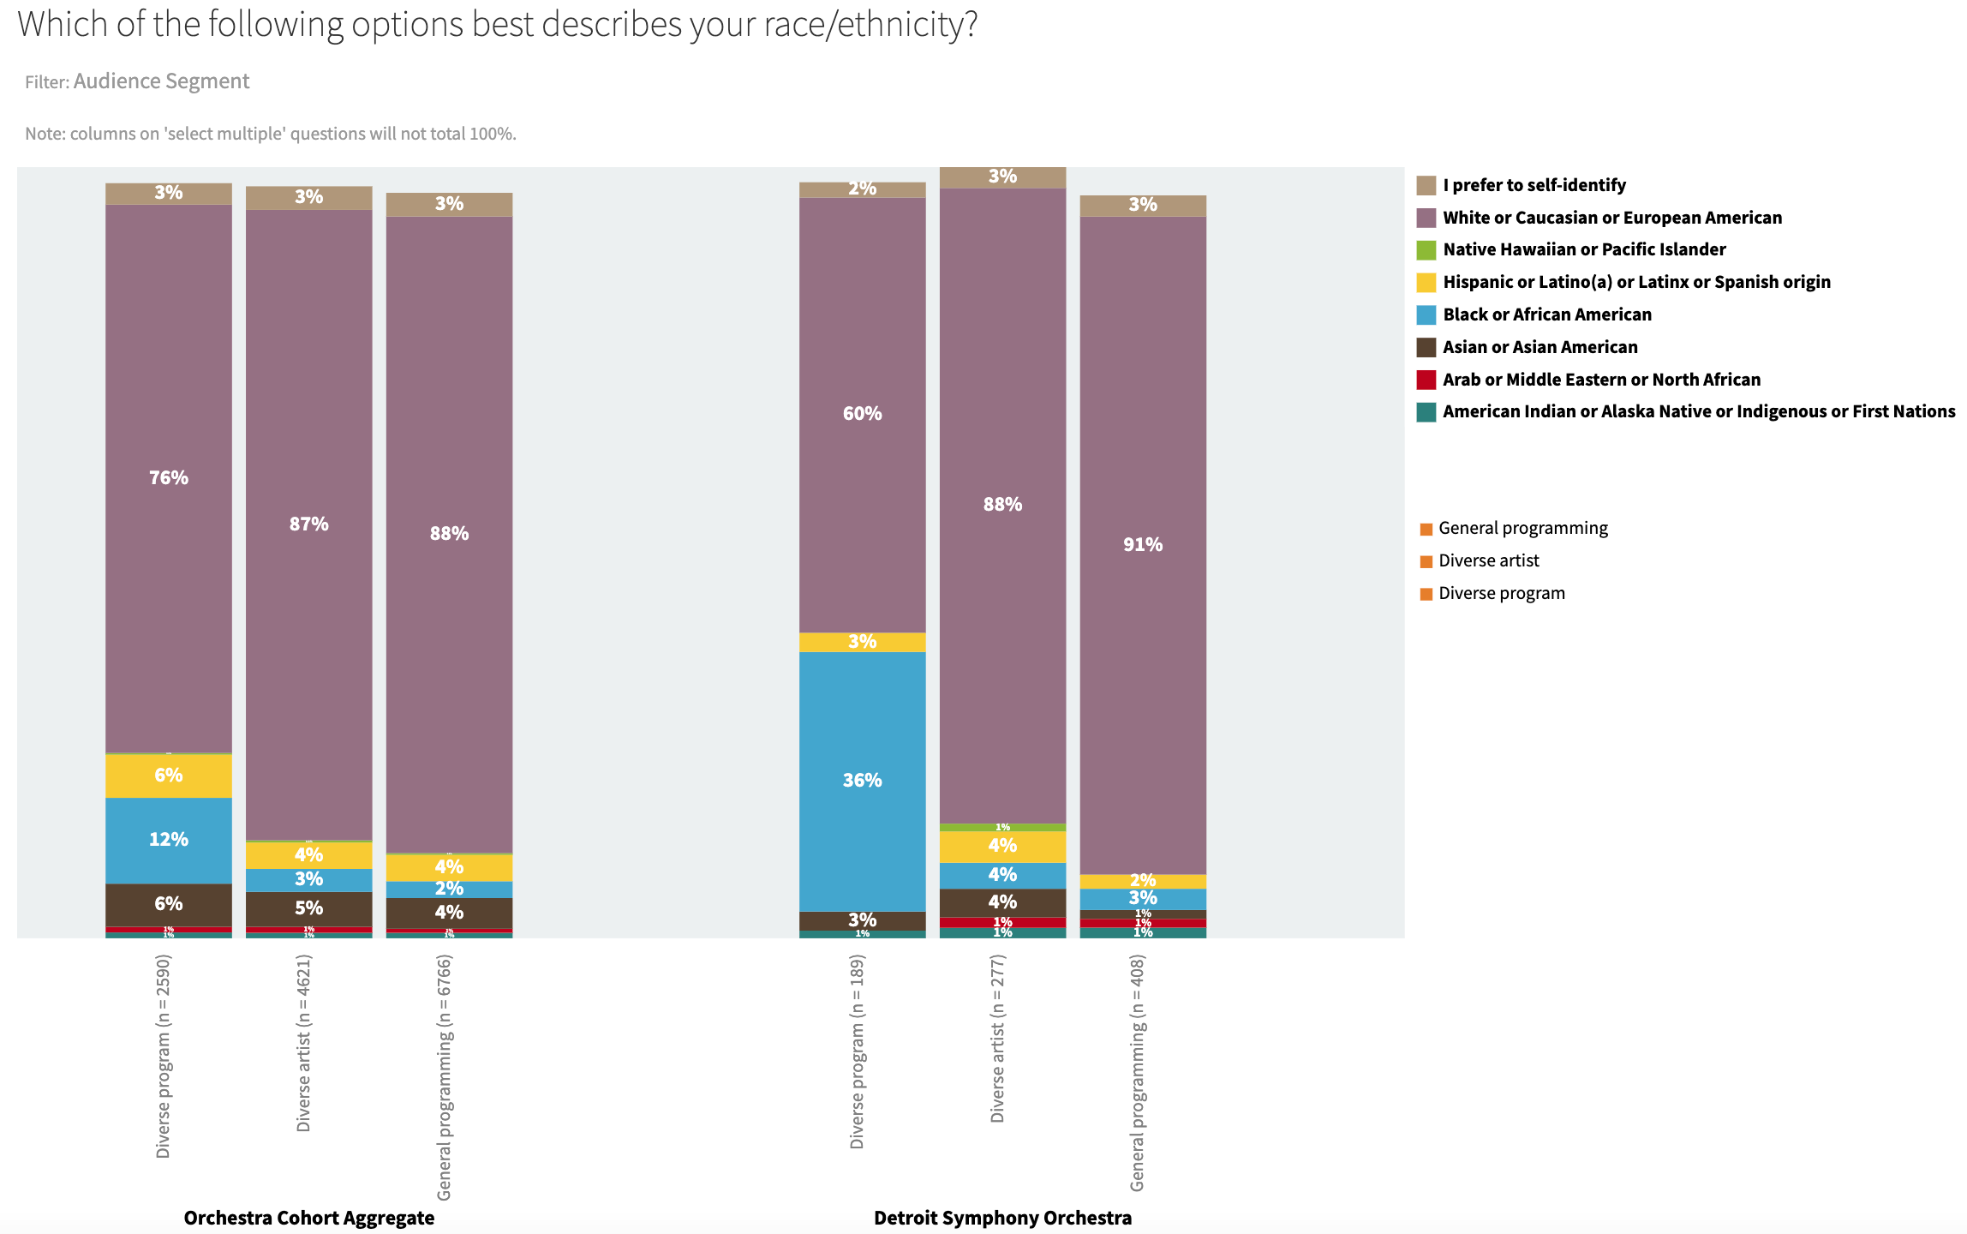
The DSO succeeds in attracting more diverse audiences to musically diverse programs

Slide 11
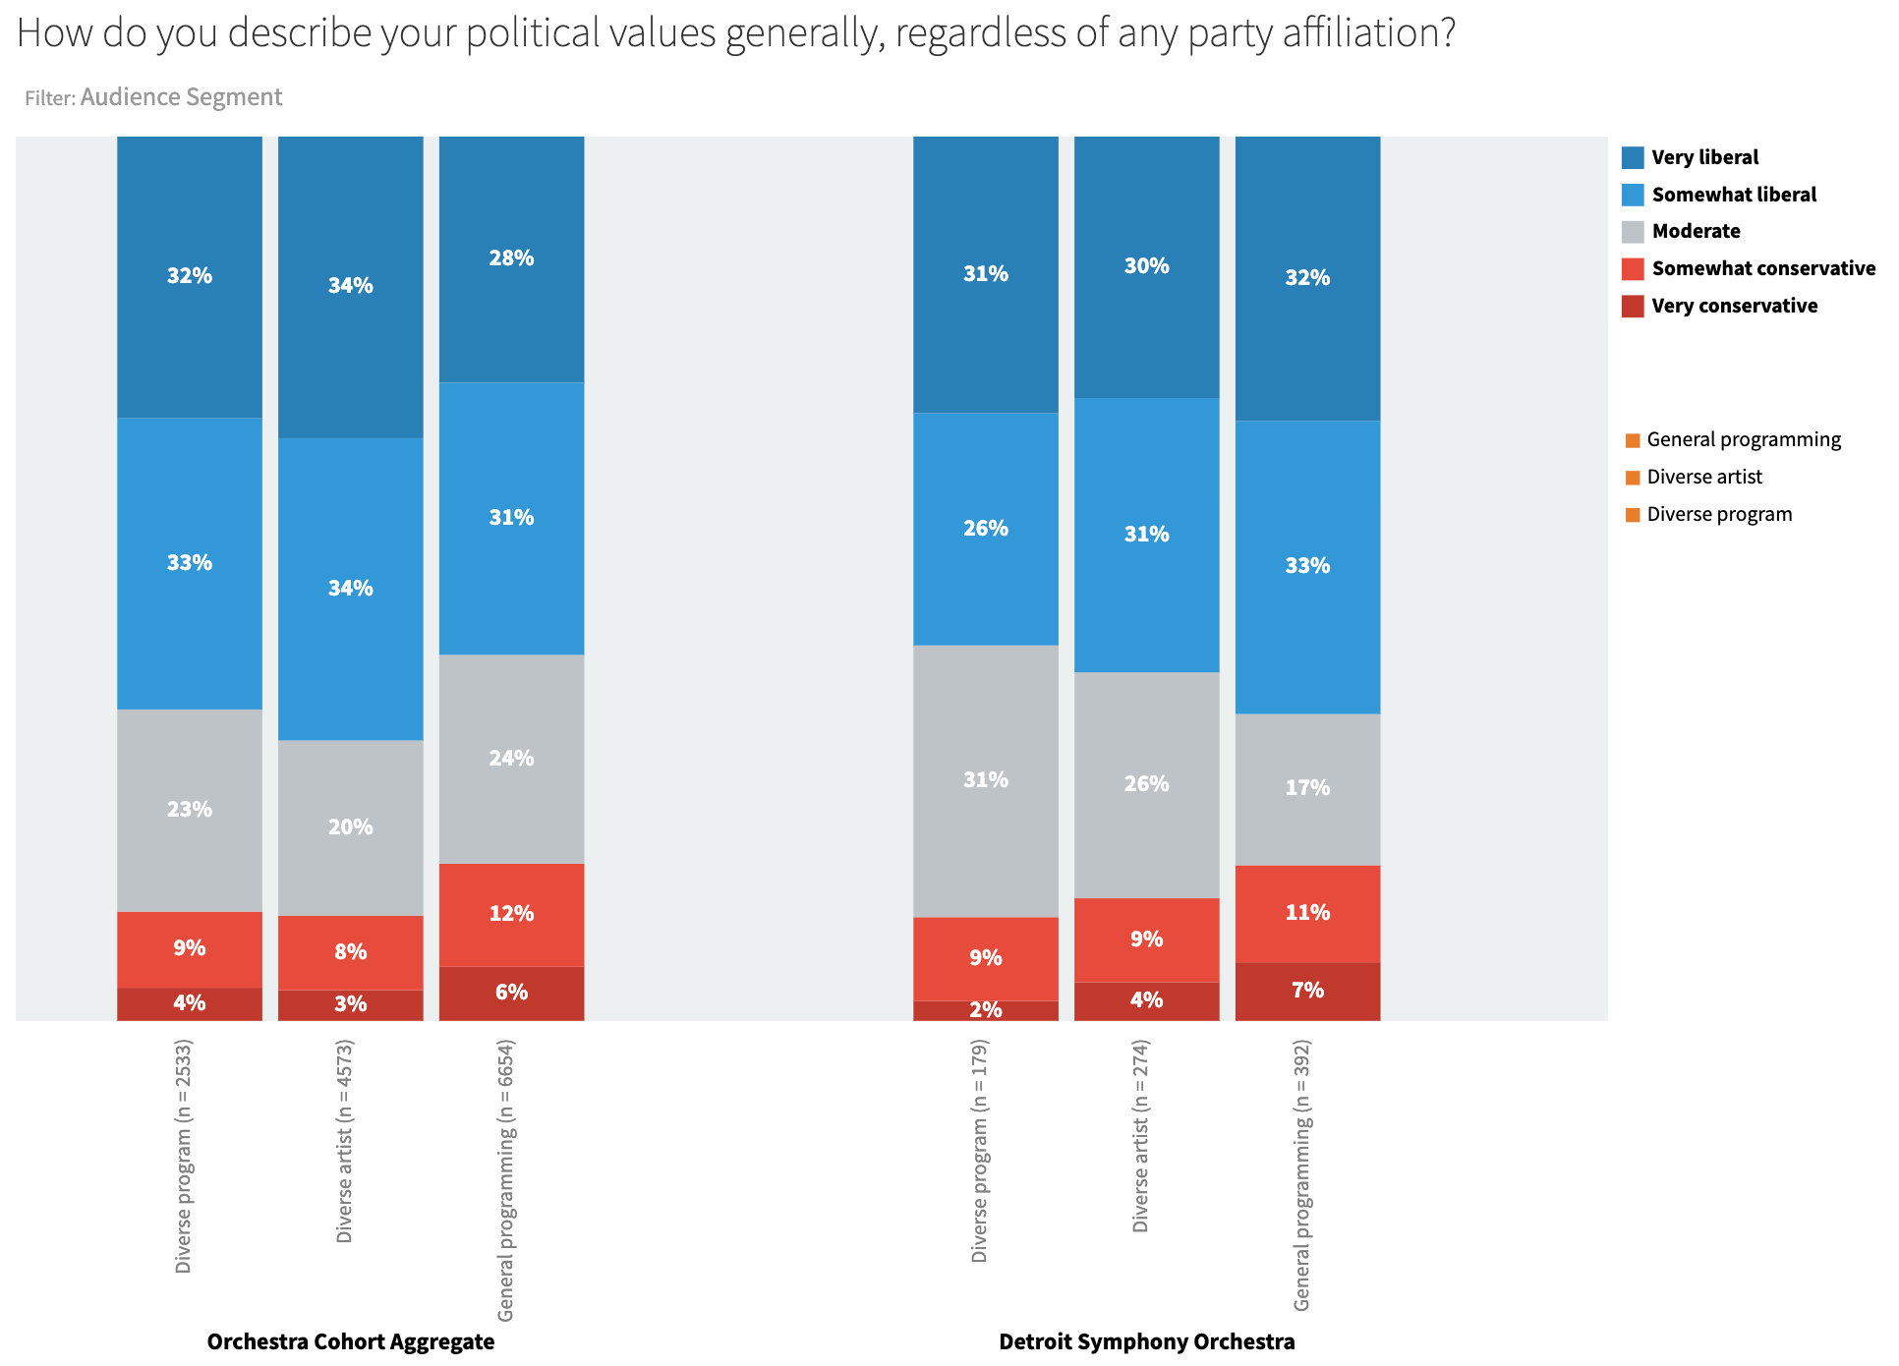
The DSO’s respondents skew towards liberal political values, consistent with aggregate results

Slide 12
Feeling welcome or unwelcome

Slide 13
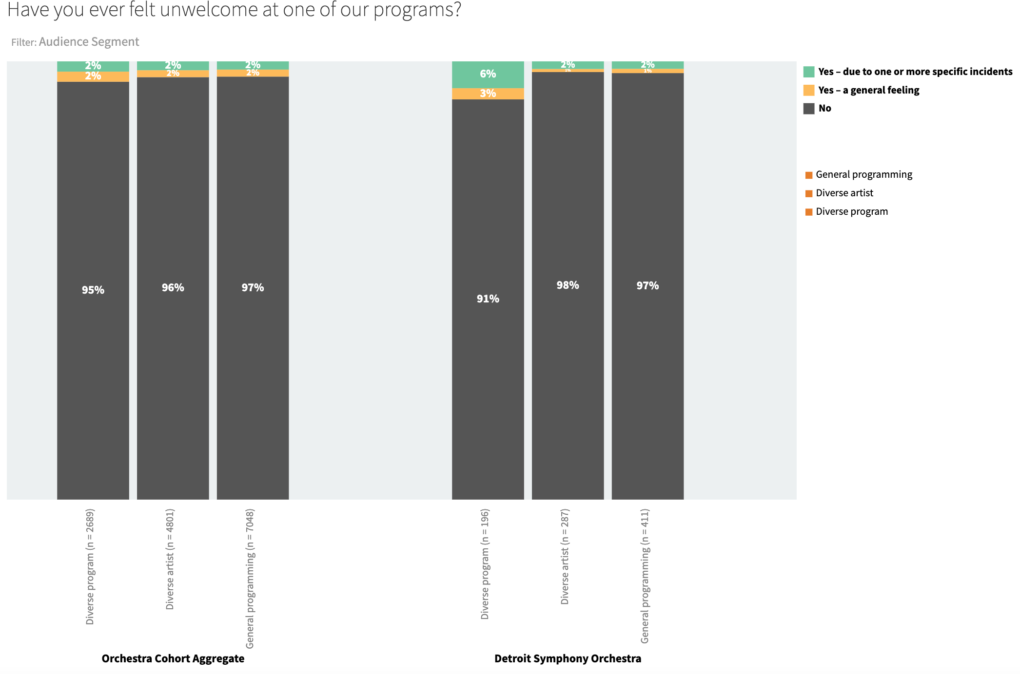
Great news - only very small percentages of DSO respondents have ever felt unwelcome.
On average, respondents of color (all races/ ethnicities) are twice as likely as whites to say they’ve ever felt unwelcome (aggregate data)

Slide 14
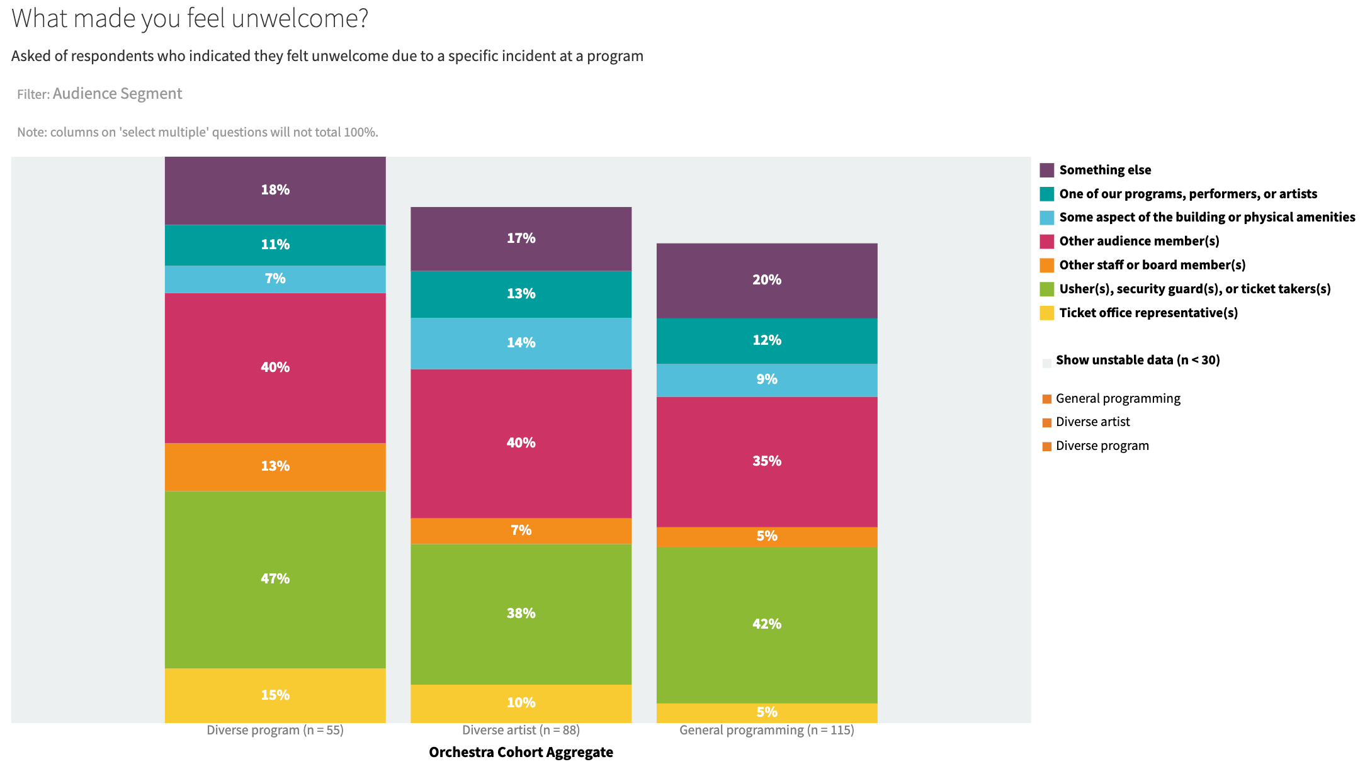
Of those who’ve ever felt unwelcome, most cite front of house issues and other audience members’ behaviors (aggregate)
Front-of-house staff should examine the wealth of responses to an open-ended follow-up question to gain insight into what makes people feel unwelcome.

Slide 15
Questions for discussion
What “should” the audience experience “look like” and are we clearly messaging this?
How do we mitigate the natural tensions within the generational divides in our audiences when it comes to enforcement of performance etiquette?
How do we exhibit and encourage inclusivity knowing that the lifestyles, expectations, habits, and comfort levels of different generations are different?
How can we address front-of-house issues to ensure that the more diverse audiences we are trying to develop have a more welcoming experience?

Slide 16
Attitudes about “Inclusion”
For the purposes of this survey, we define “inclusion” as work that organizations like ours do to ensure that all people feel invited to attend, and, when they come, feel welcome, valued, and respected.

Slide 17
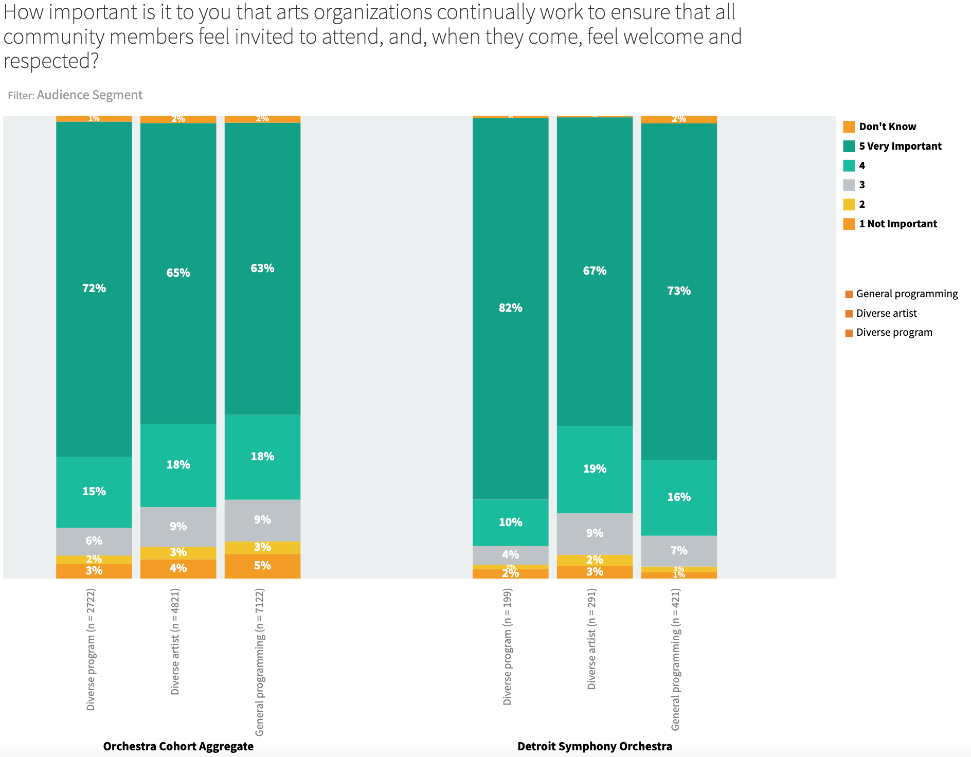
DSO respondents overwhelmingly support the efforts of arts organizations to be inclusive, esp. those who attend diverse programs.

Slide 18
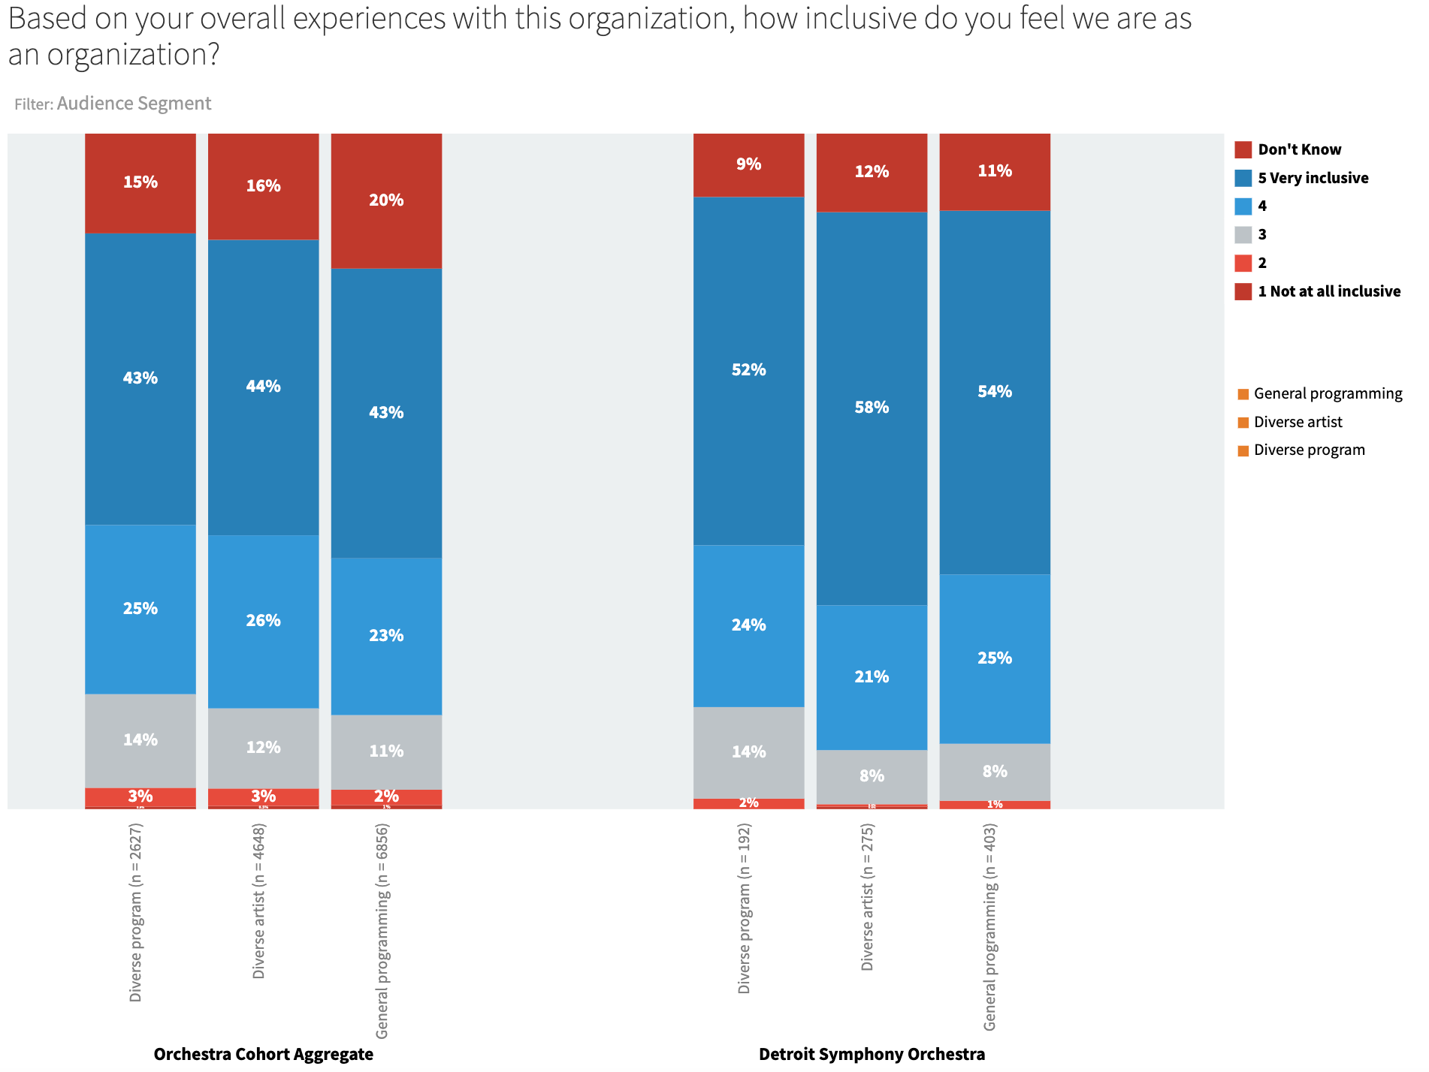
Compared to aggregate results, DSO respondents are more likely to describe the DSO as “very inclusive.” Diving deeper, African American respondents are less likely than white respondents to perceive their local orchestra as “inclusive.” (aggregate data)

Slide 19
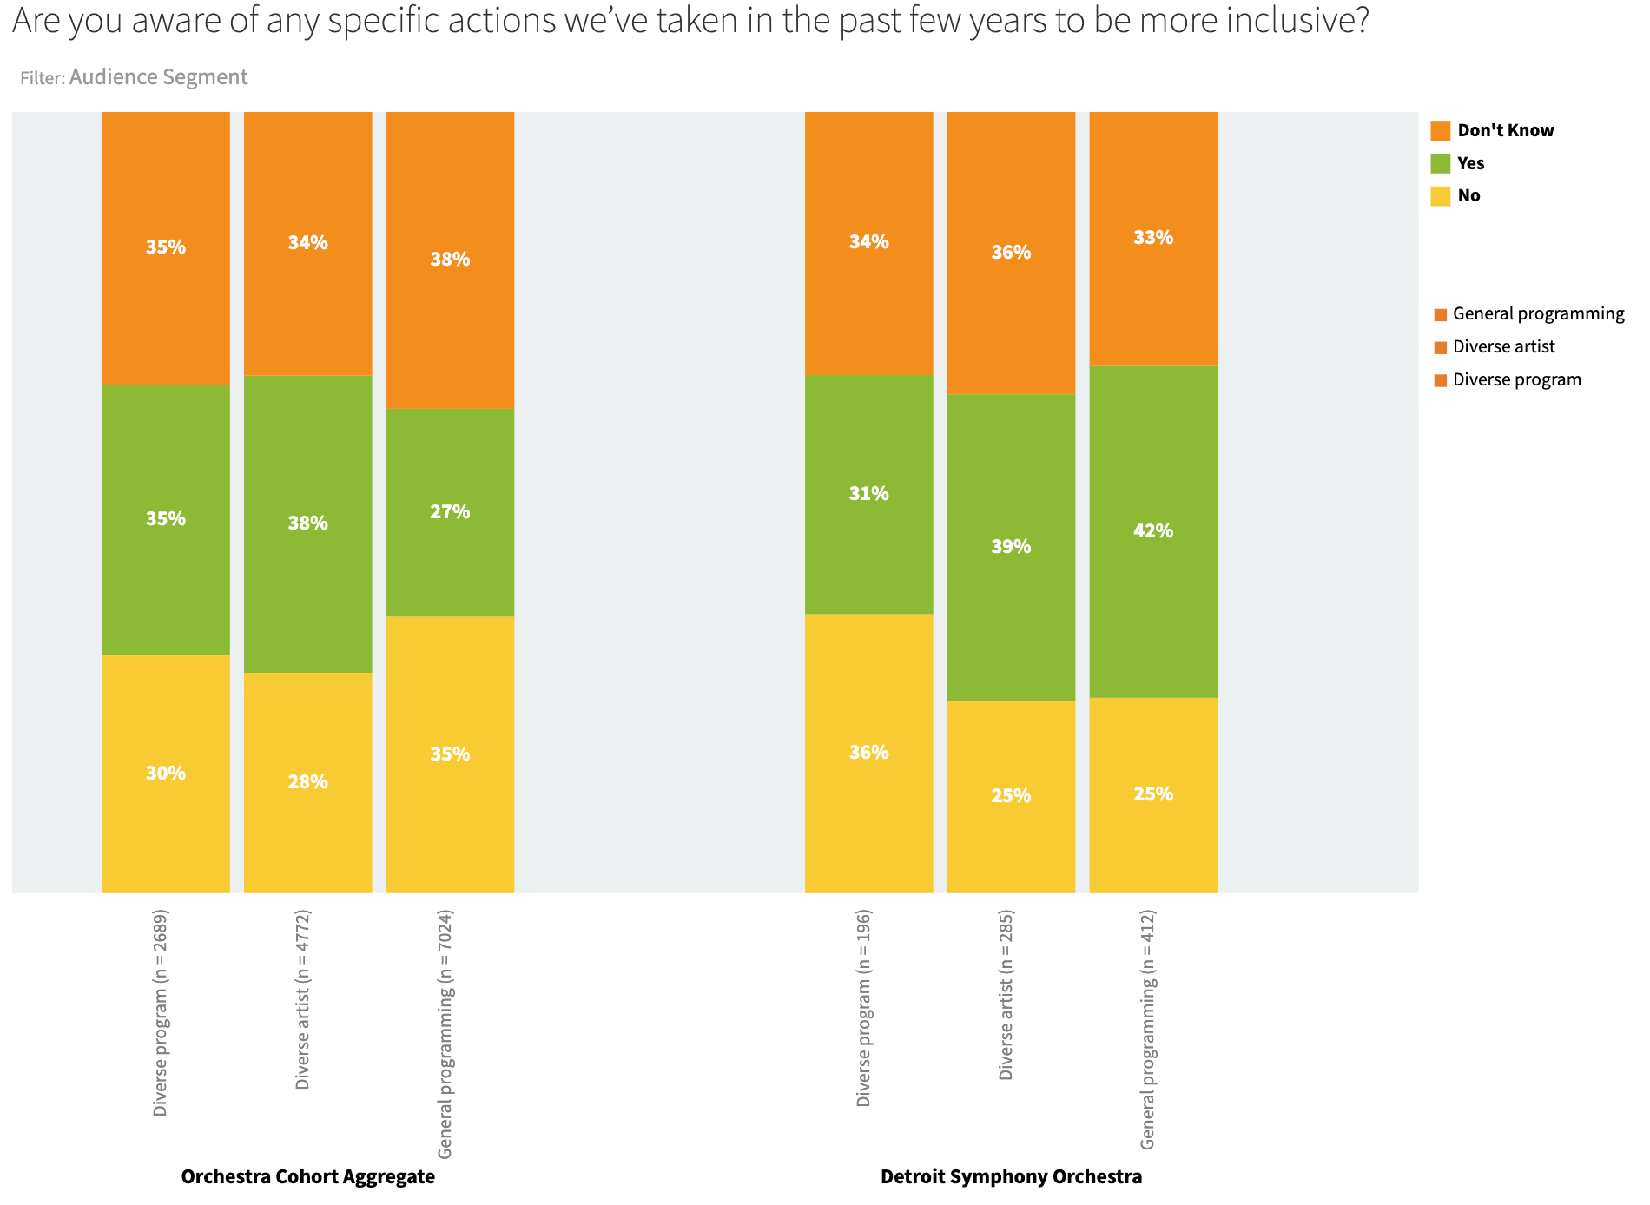
While feelings about the DSO’s inclusivity are positive, only about 30% to 40% of respondents can think of a specific action the DSO has taken to be more inclusive. Many cannot think of anything, or say they “don’t know.” Those who answered “Yes” were asked to give an example of a specific action. Results illustrate how the DSO’s efforts towards inclusivity are legible to audiences.

Slide 20
Questions for discussion
Inclusion is signaled at every step of the marketing process, and at every touch point of the audience experience.
Where are your strong points and your weak points in both signaling inclusivity and making it real?
How might the orchestra be more explicit in its communications about inclusivity?

Slide 21
Attitudes about “Diversity”
Diversity is reflected in the actions that organizations like ours take to ensure that our board of directors, staff and artists reflect a range of perspectives, cultural backgrounds and life experiences. Diversity can refer to race, ethnicity, socioeconomic status, gender, sexual orientation, religion, disability, age, language, and other factors.

Slide 22
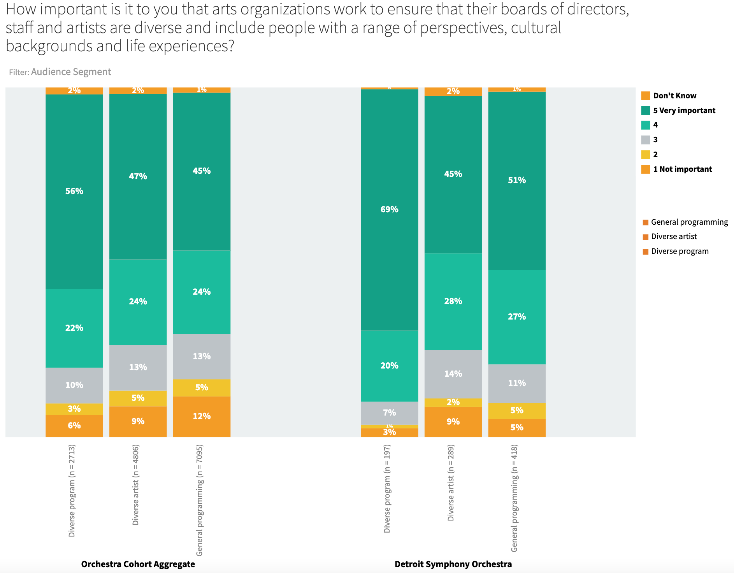
A majority of DSO respondents feel that arts organizations should work towards greater diversity, especially those who attend diverse programs

Slide 23
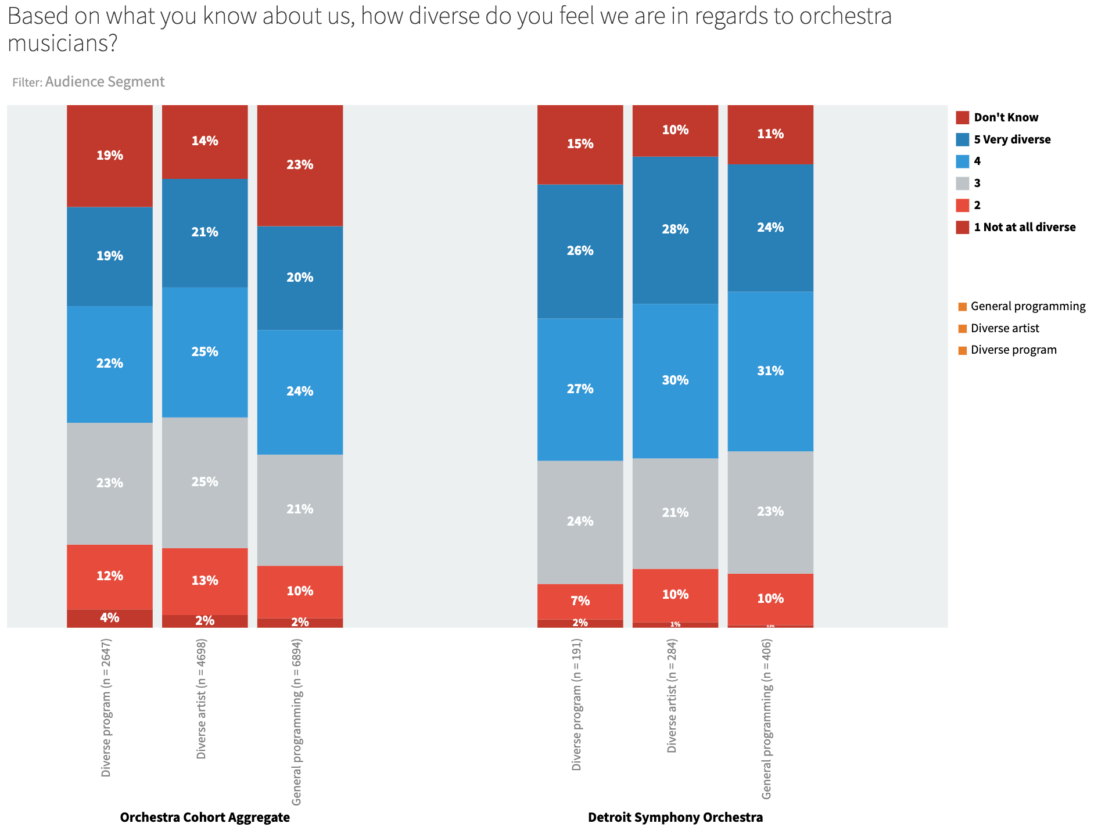
Compared to aggregate figures, DSO respondents are a bit more likely to see diversity in the orchestra musicians. Note here the relatively low percentages of respondents who answered “don’t know.”

Slide 24
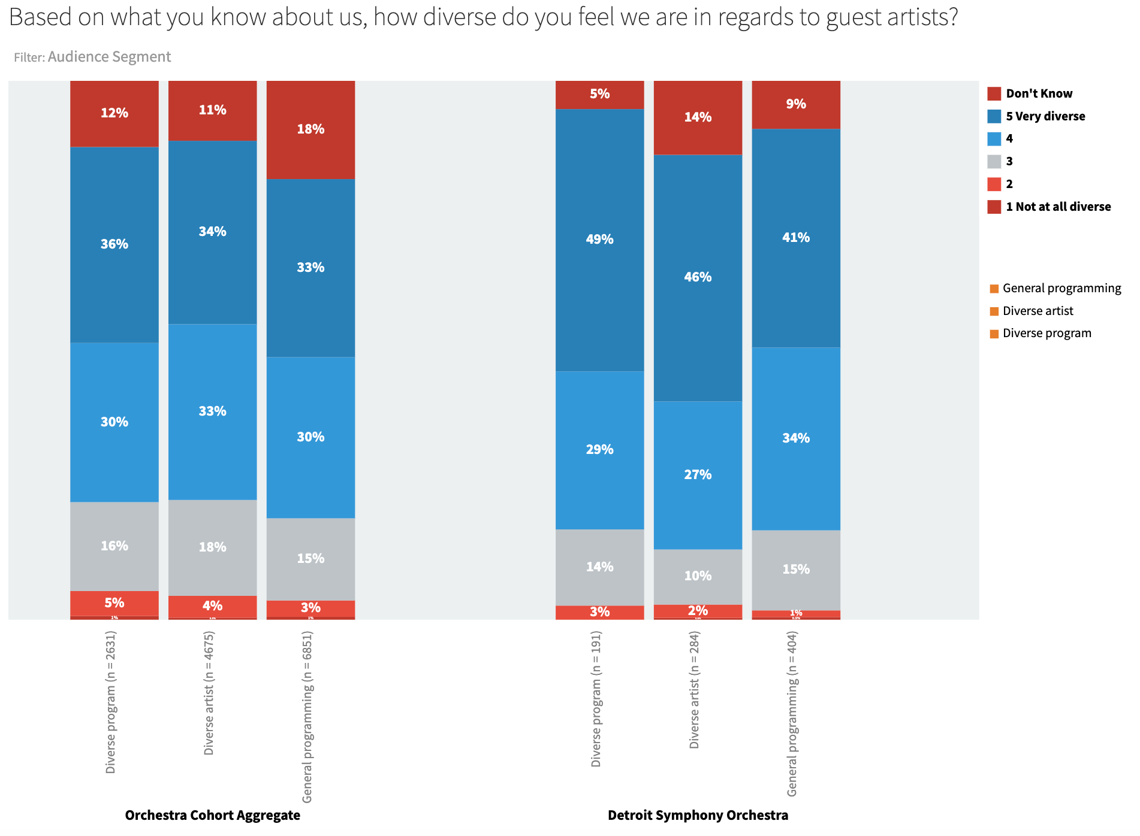
Much stronger levels of diversity are reported for “guest artists” – both in aggregate, and for the DSO. Again, note here the low figures for “don’t know.”

Slide 25
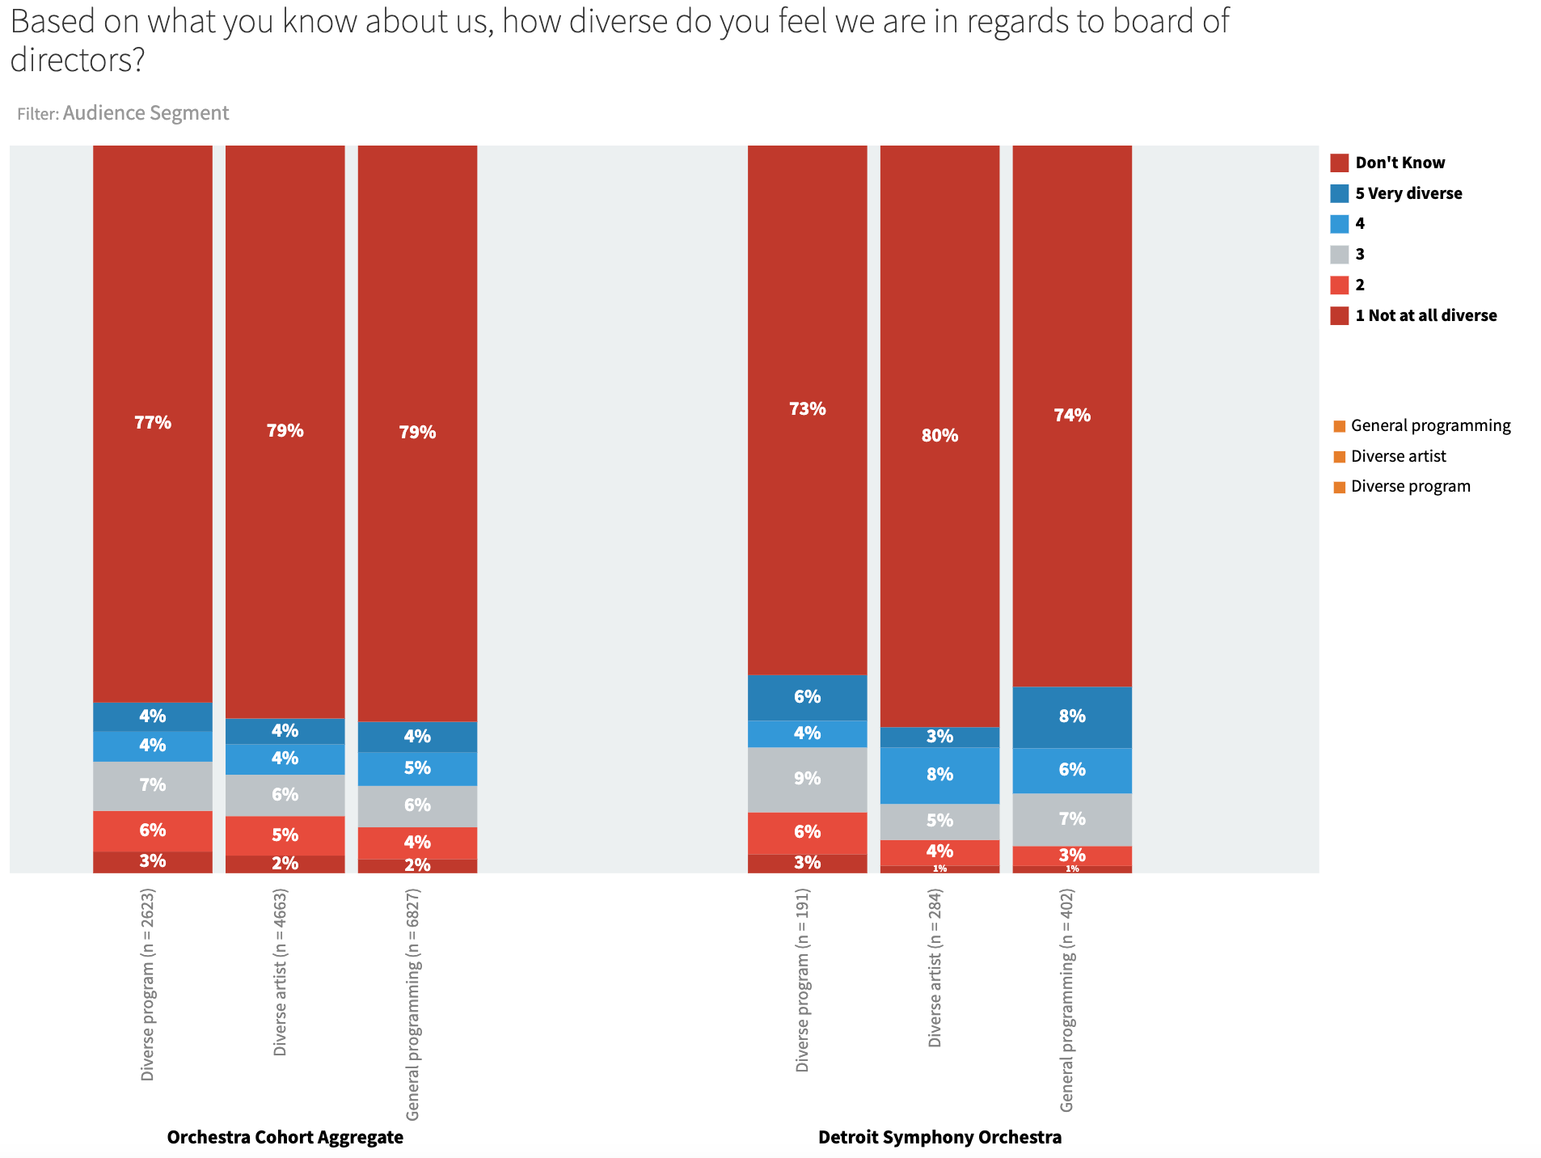
Three-quarters of DSO respondents have no idea how diverse the board of directors is. What more might we do to communicate about the diversity of board and staff?

Slide 26
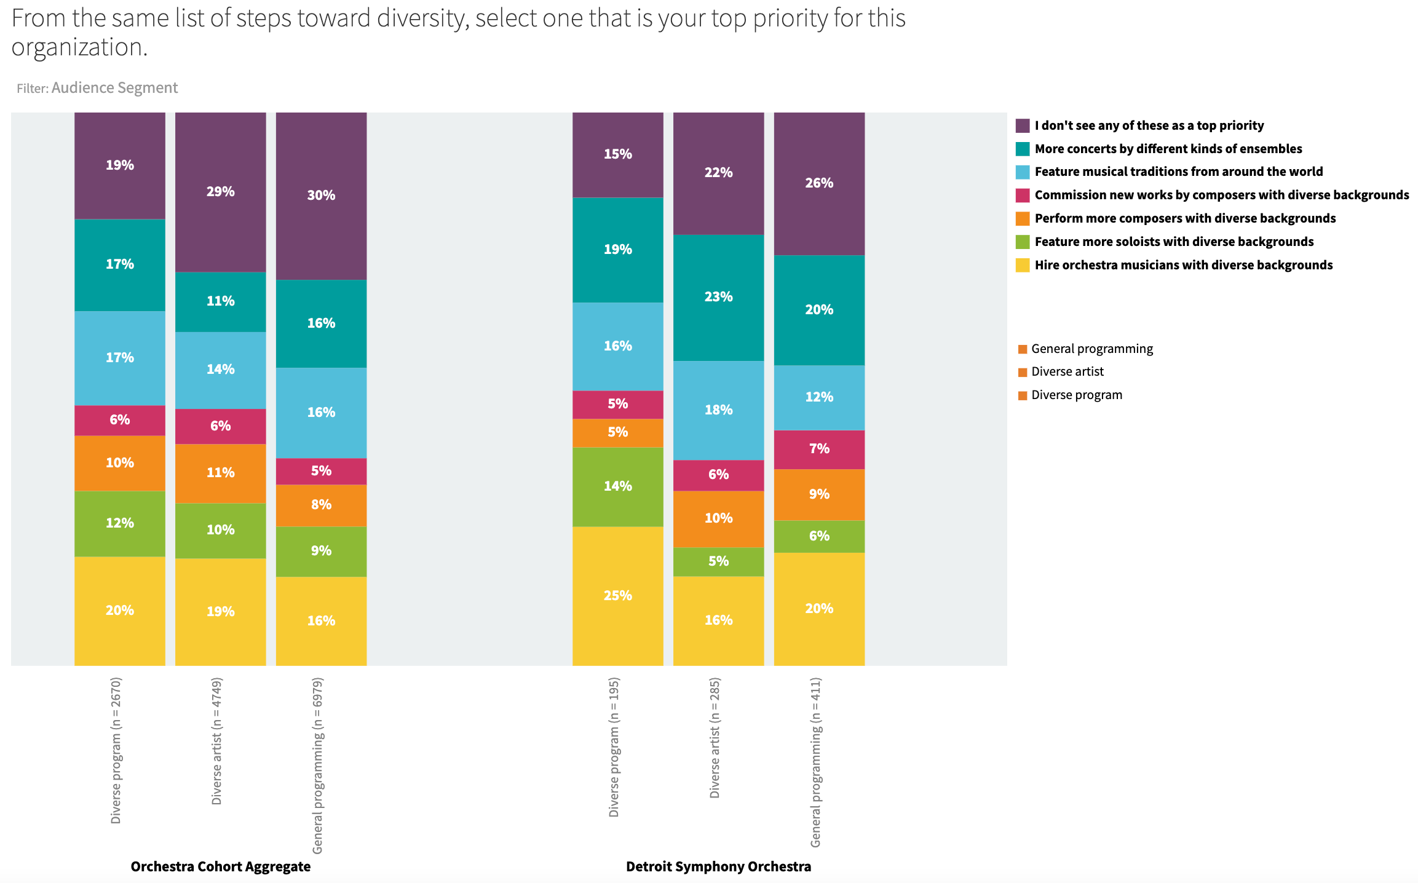
When asked what steps we might take towards greater diversity, the highest support was expressed for “more concerts by different kinds of ensembles,” “hire orchestra musicians with diverse backgrounds,” and “feature musical traditions from around the world.” However, roughly a quarter of all respondents don’t think any of these steps are a priority.

Slide 27
Questions for discussion
How can we address the lack of knowledge about staff and board makeup, especially through communications to those for whom diversity is important?
The study finds differences in opinions and priorities around diversity. A small group of respondents – about 10% – doesn’t care at all about diversity, while about 50% say its “very important.” How do we act on this information?
Given the visibility of the orchestra musicians to the audience, the diversity level of the orchestra is a critical indicator of our progress towards diversity. What can be done to push forward on this front?
The data suggests that cultivation of younger audiences as lifelong symphony supporters will result in greater support for EDI efforts in the long-term. What strategies can we employ here?

Slide 28
Attitudes about “Equity”
In using the term “equity,” we refer to the policies and structures that organizations like ours put in place to empower people who’ve been excluded or oppressed in the past, to change systems that perpetuate bias, and to ensure fair and just treatment of staff, artists, and audiences.

Slide 29
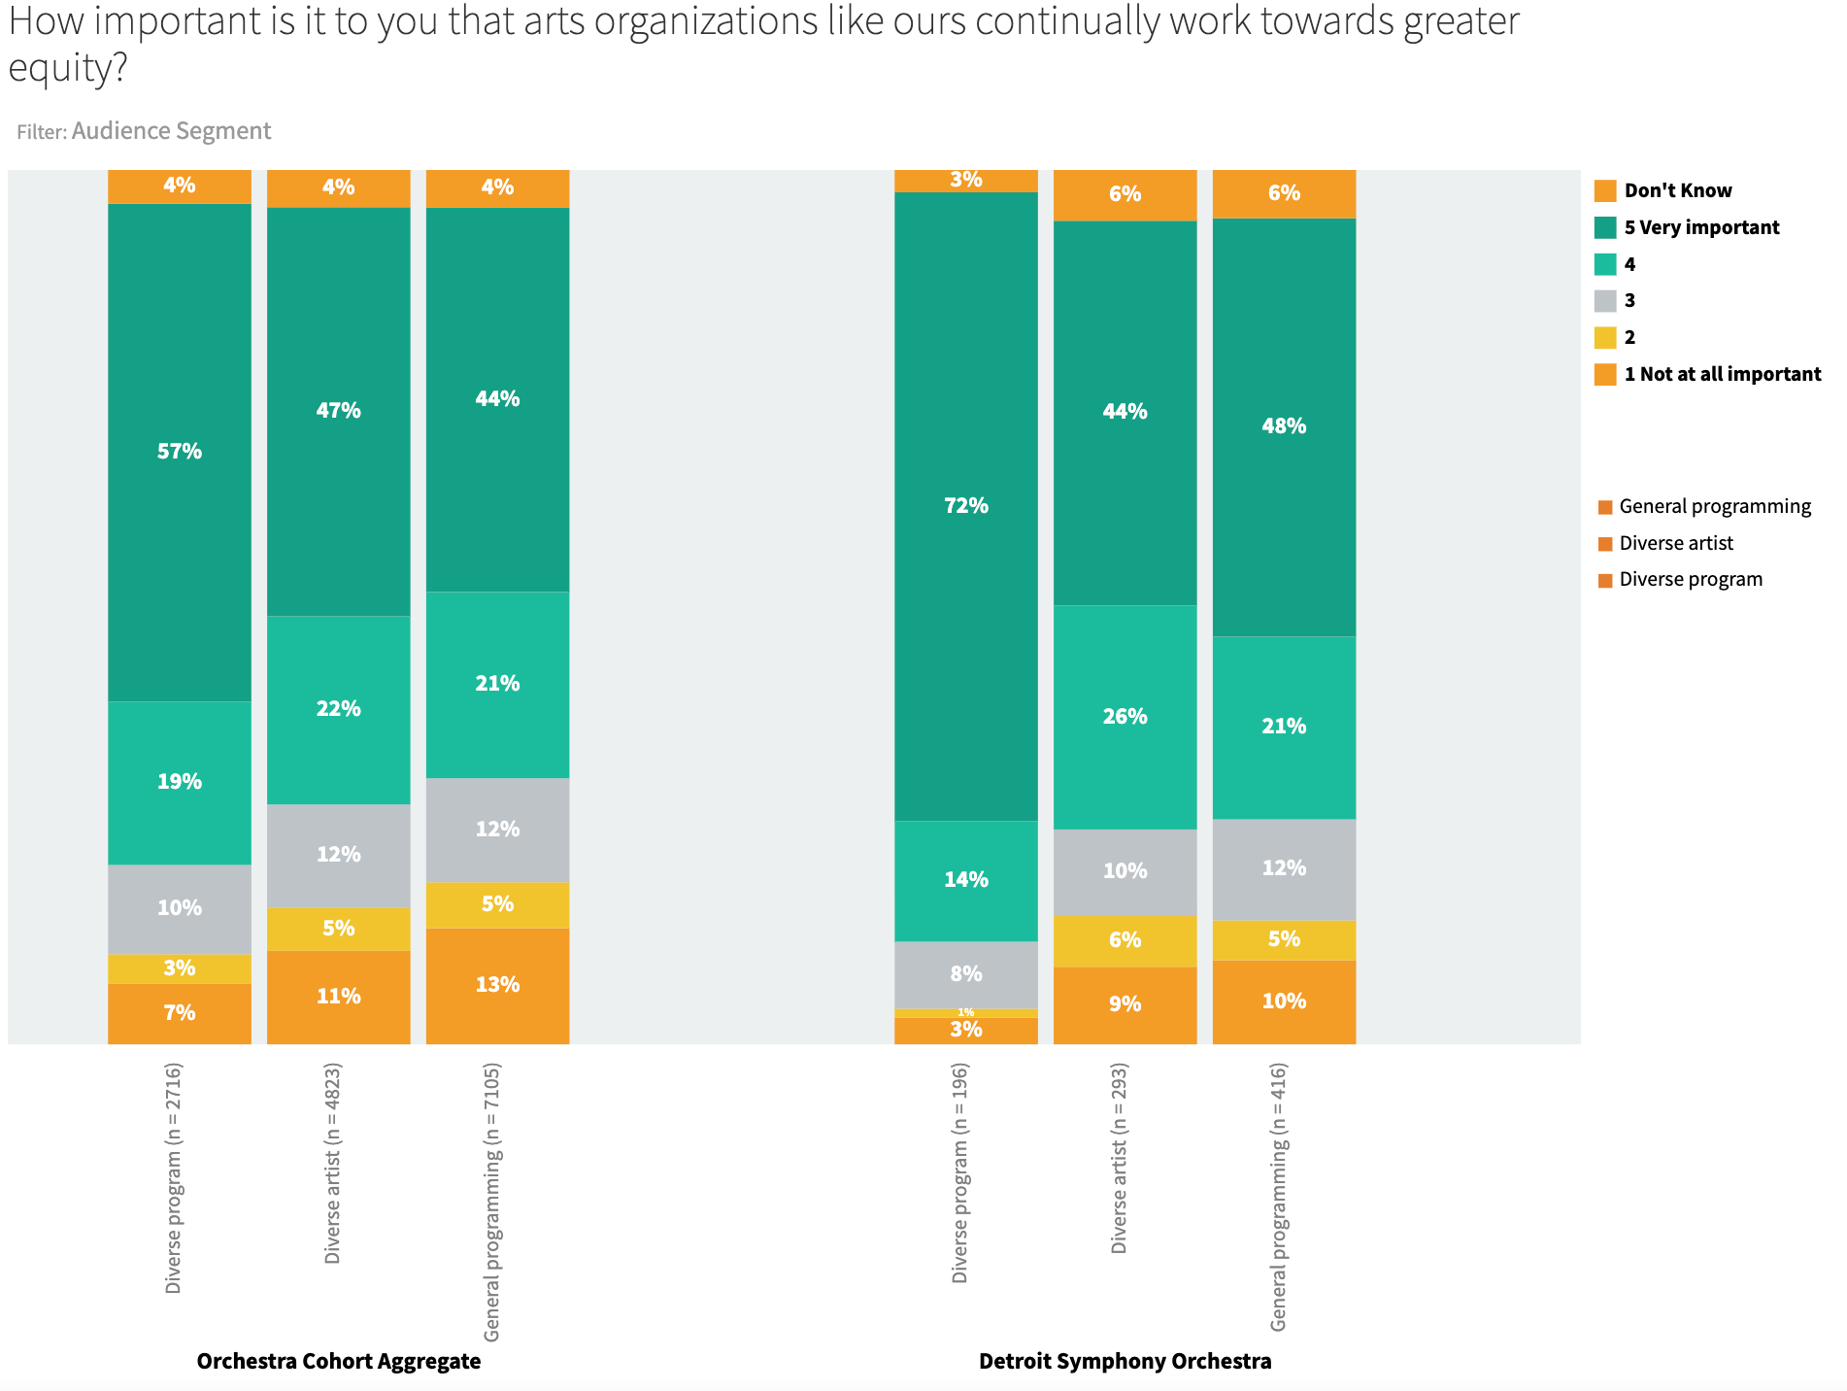
A majority of DSO respondents feel that arts organizations should work towards greater equity, especially those who attend diverse programs Diving deeper, women, LGBTQ+, Hispanic or Latino, and African American respondents are much more likely than white respondents to believe that arts organizations should work towards greater equity. (aggregate data)

Slide 30
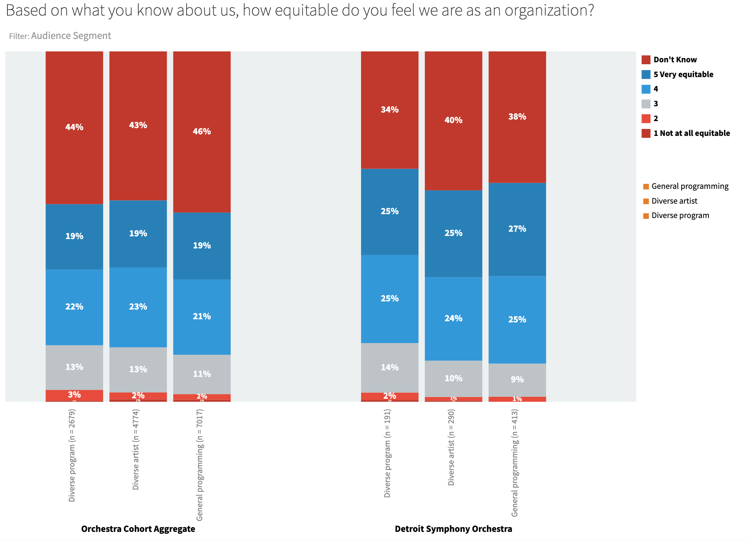
In aggregate, nearly 45% to 50% of all respondents “don’t know” how equitable an organization their orchestra is. Should they? Those who could cite action steps towards “equity” tended to cite the same things as they cited under “inclusion.” Is equity too abstract of a construct for audience members to adjudicate? Should we think of equity more as a core value, the outcomes of which are reflected in other sorts of indicators (e.g., diversity in audience, programming)?

Slide 31
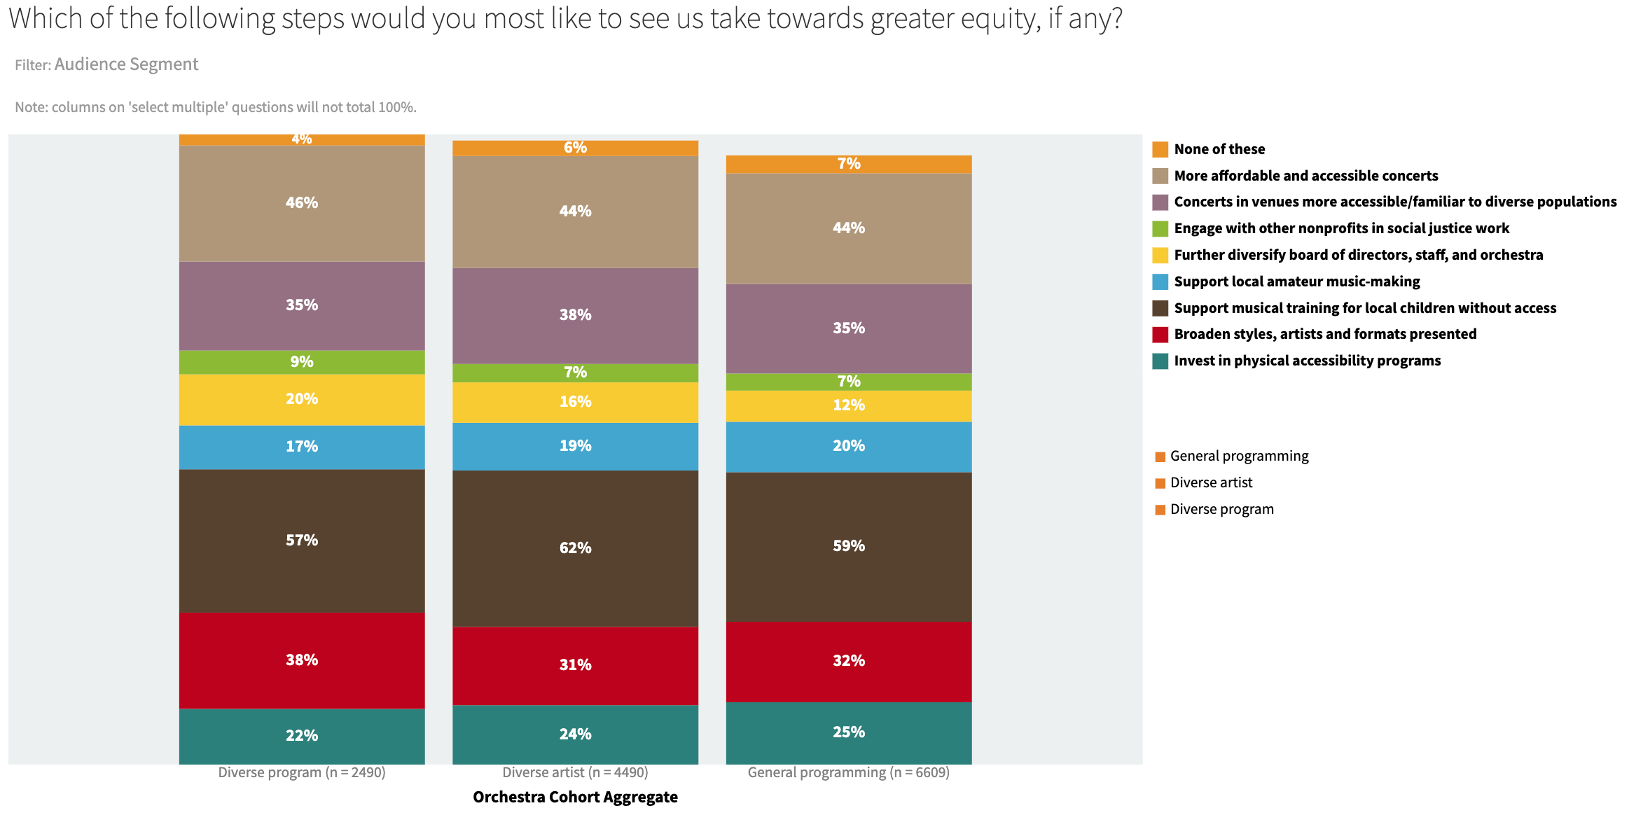
The most commonly supported steps toward greater equity desired by audiences are “support musical training for local children without access” and “more affordable and accessible concerts”

Slide 32
Questions for discussion
Moving beyond inclusion towards equity means shifting the structures of power, decision-making, and policy. How consistent is our model of program planning and artistic decision-making with the principles of equity? What role can we play in making culture more democratic?
How far are we willing to go to speak to a broader public through our programming? Moving forward, should we place more emphasis on the diversity of programming or the diversity of guest artists?
How can we improve communications about what we already do to serve a broader public, in order to better share our progress towards greater equity? What stories can we tell?

Slide 33
Patrons’ values and priorities in regards to EDI

Slide 34
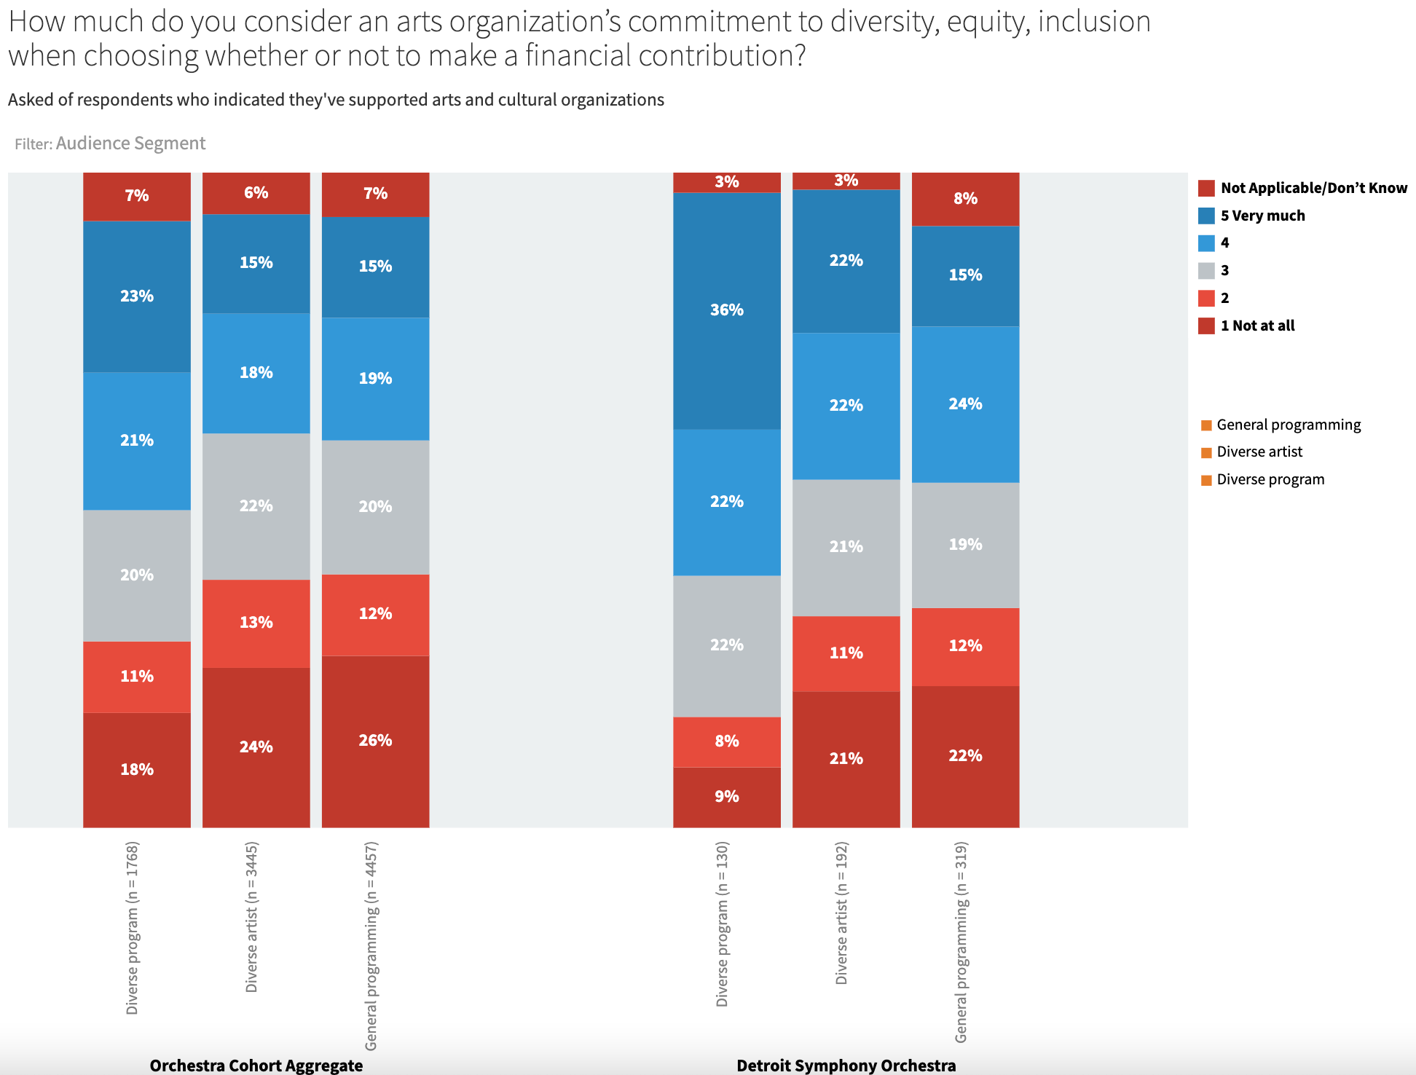
Respondents are divided as to whether they consider an arts organization’s commitment to EDI as a criterion for giving (aggregate data); for the DSO, respondents who attend diverse programs are much more focused on this.

Slide 35
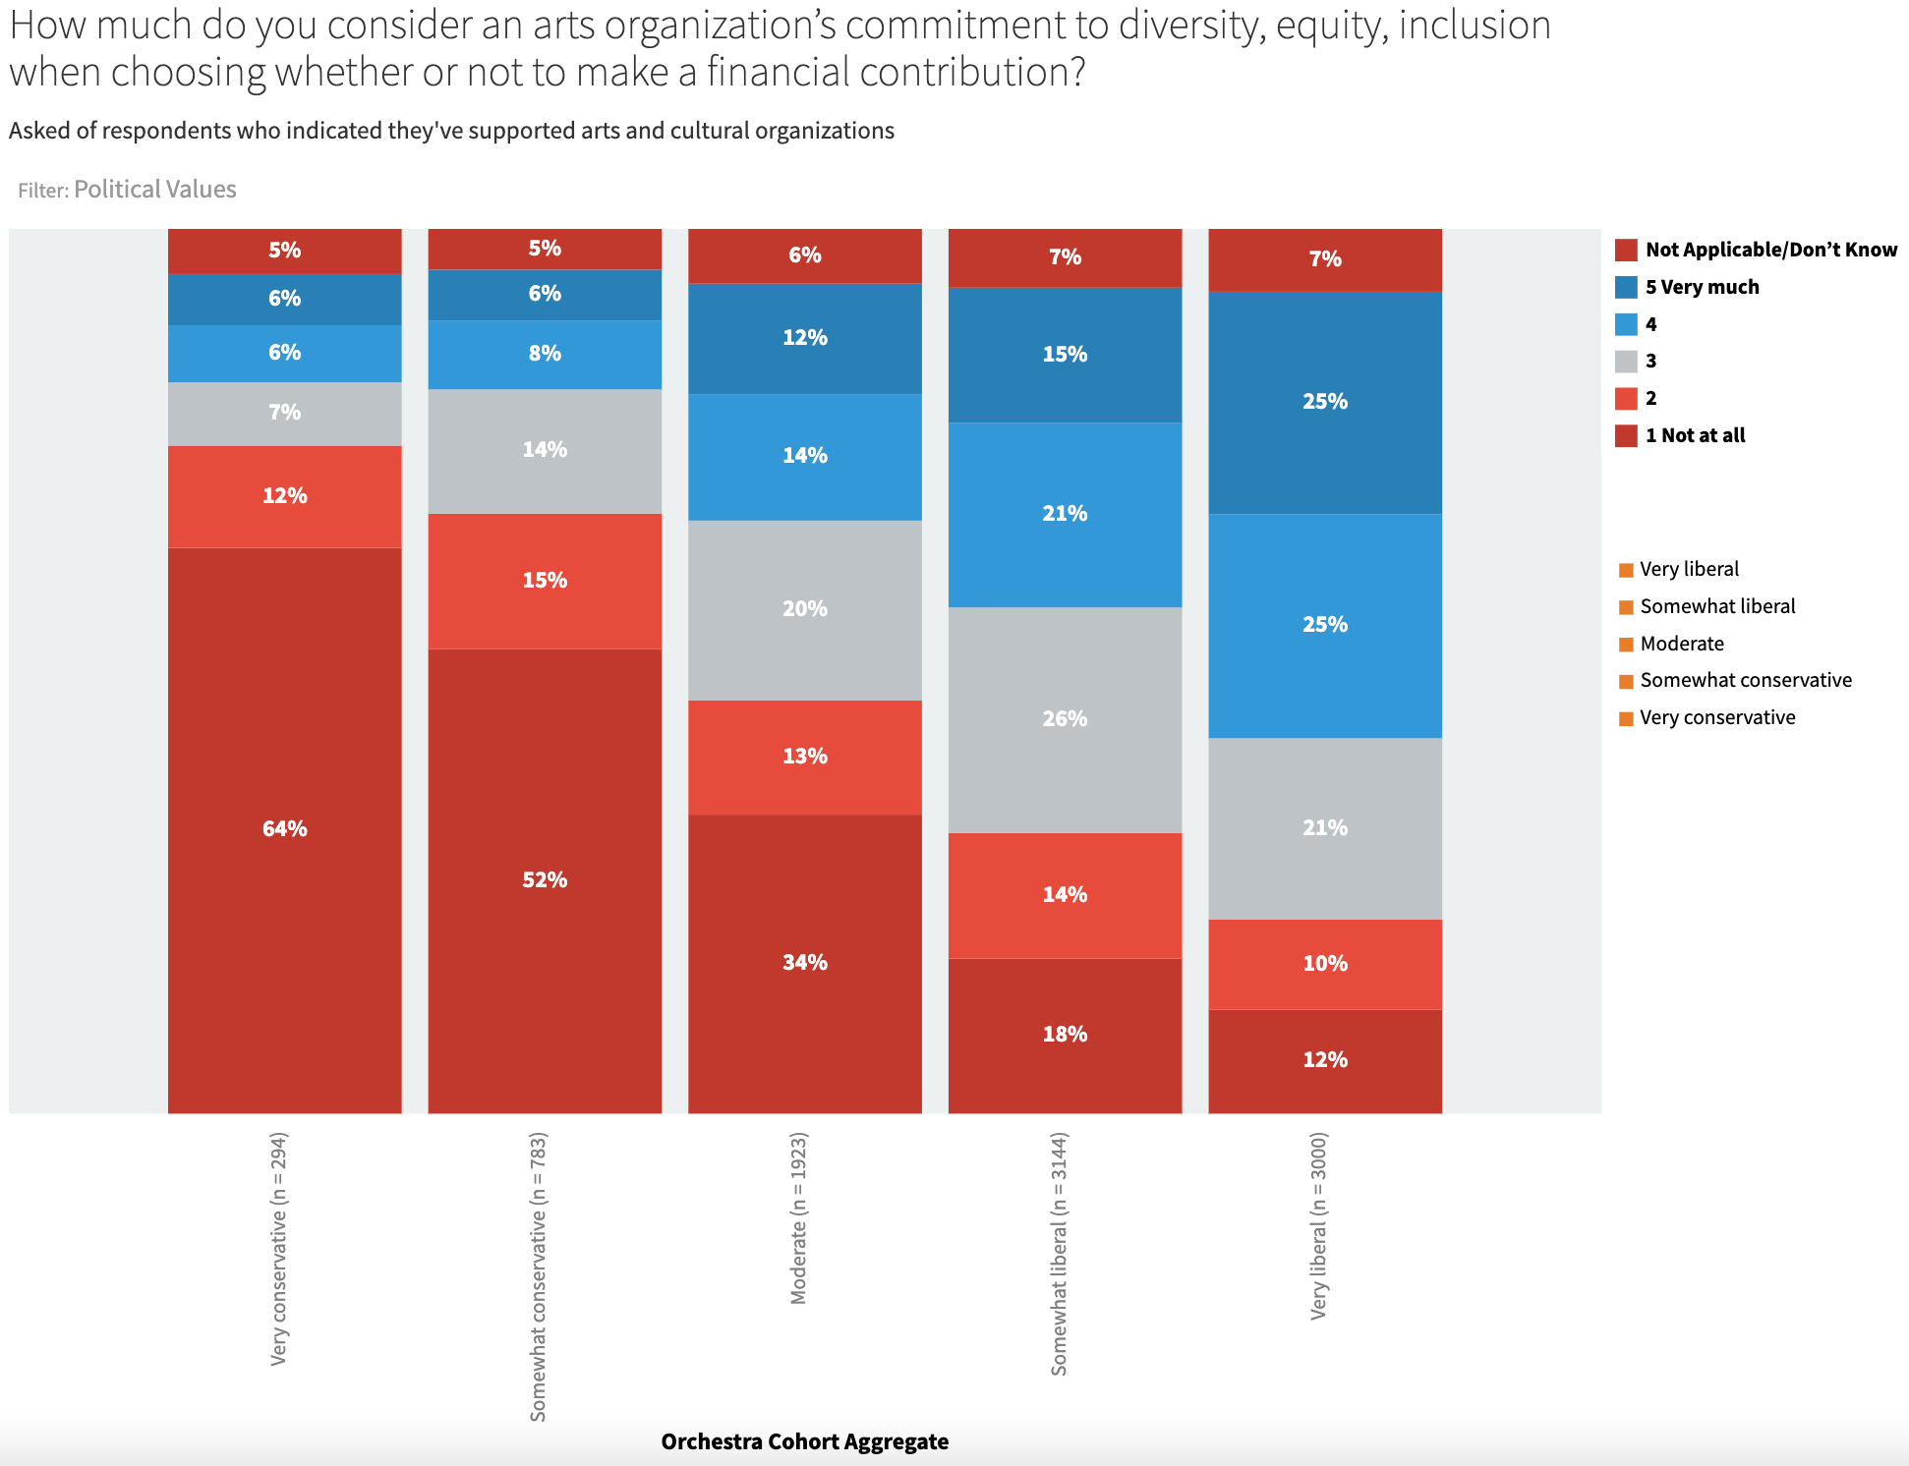
Here you can see the very strong relationship between EDI as a criterion for giving and respondents’ political values. (aggregate data)

Slide 36
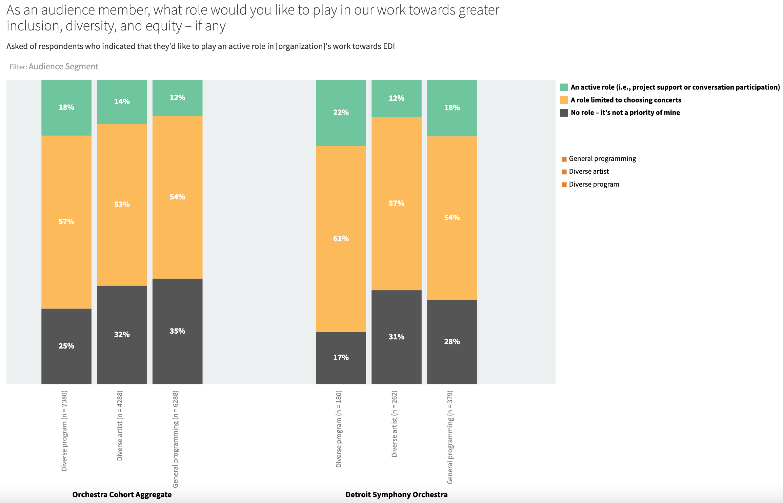
When asked what role they’d like to play in our work towards greater EDI, most respondents indicated their role would be limited to choosing which concerts to attend (i.e., they’ll ‘vote with their feet’). A small percentage (i.e., 15% to 20%) want to play a more active role, and a quarter to a third want no role at all.

Slide 37
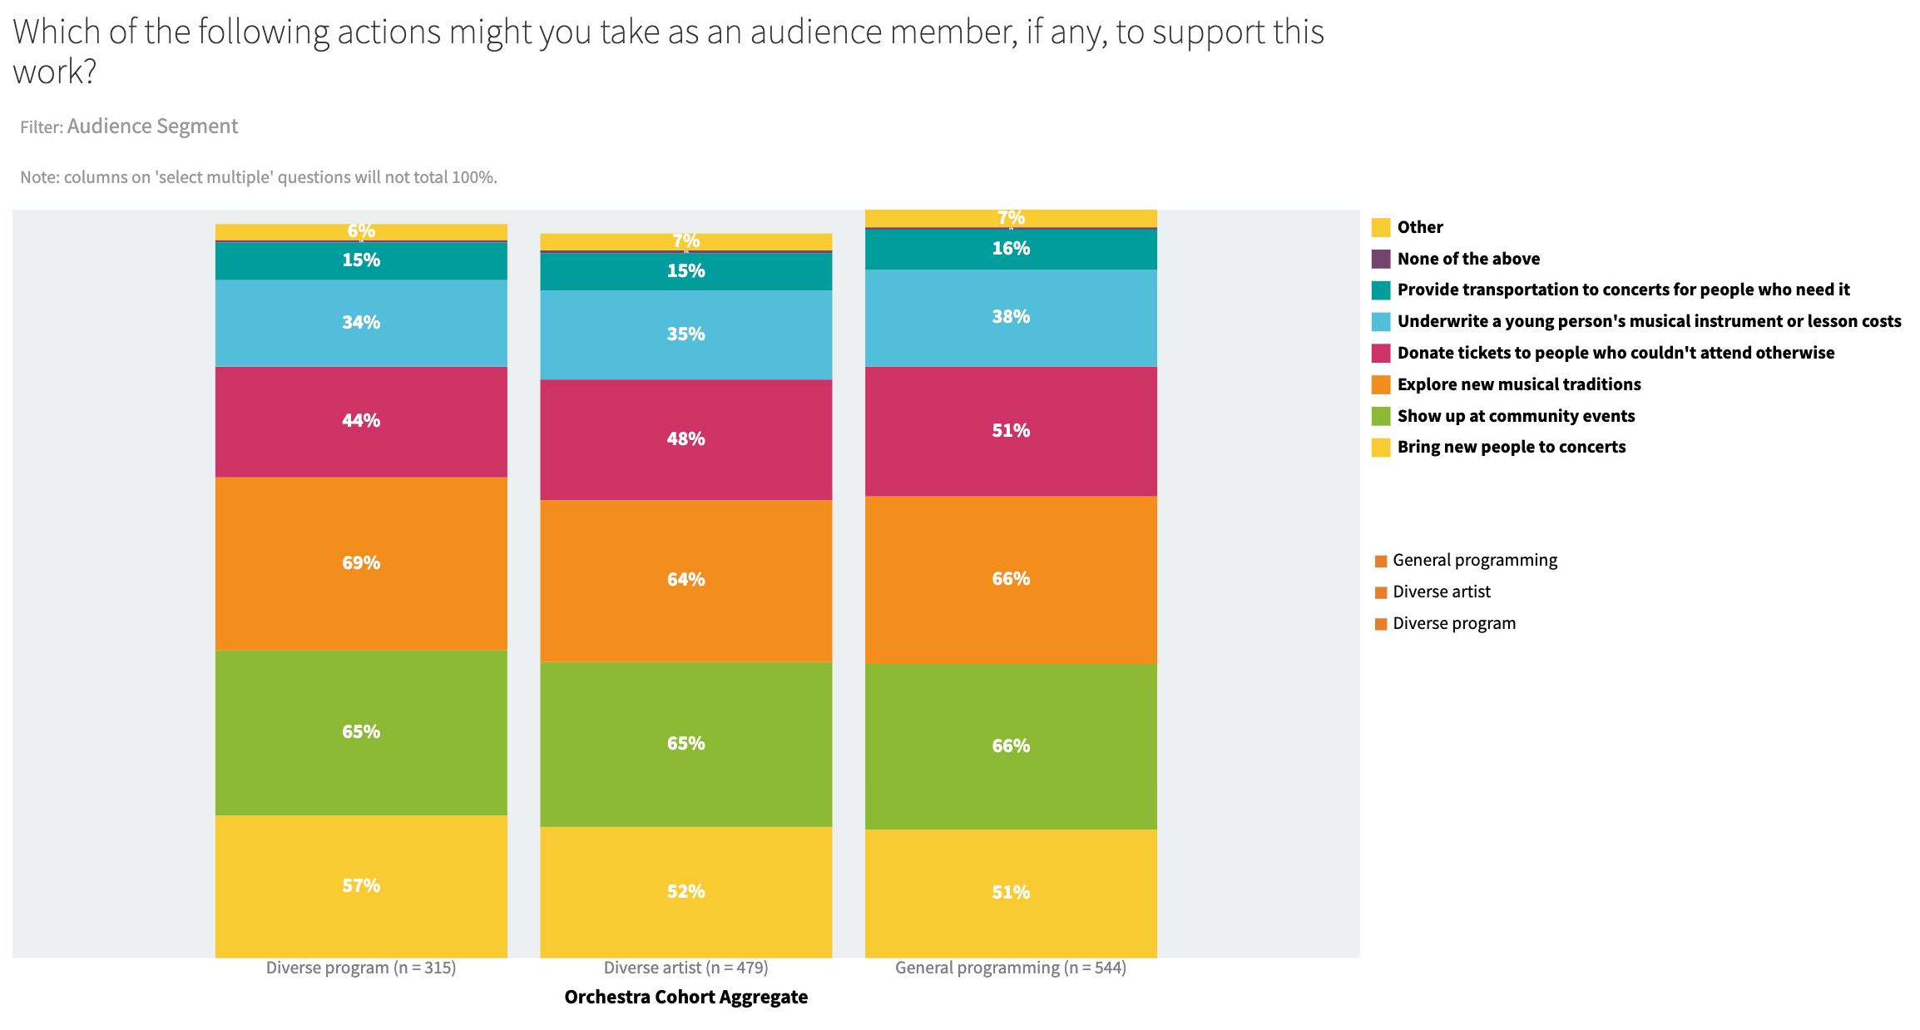
Those who expressed an interest in playing a more active role (i.e., 15% to 20% of all respondents) indicated an interest in several potential actions/programs (aggregate data), esp. “show up at community events” and “explore new musical traditions.”

Slide 38
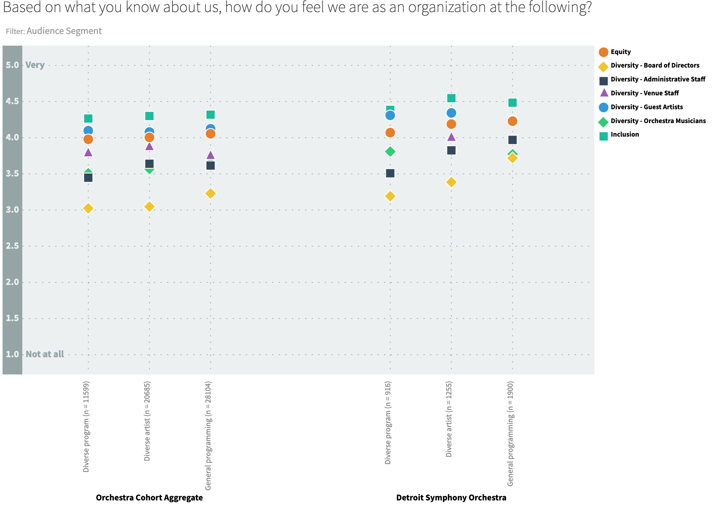
In sum, respondents gave the highest the DSO the highest marks for “inclusion” and somewhat lower marks for “equity.” These figures exclude respondents who answered “don’t know.” Perceptions of diversity of board and staff is lowest of all. Generally, DSO figures are at or above aggregate figures.

Slide 39
Questions for discussion
Results suggest that the largest share of patrons will experience the orchestra’s commitment to EDI through its programming, and some expressed interest in a broader musical palette (e.g., “more concerts by different kinds of ensembles”).
This underscores the long-term need to align programming with EDI
What can we do to capture the high level of support for EDI efforts, among the 15% to 20% of patrons who feel strongly about it? Are there new or different ticket packages or philanthropic vehicles we should think about?

